Slide 1


T-SQL for Data Science

Slide 2
Agenda
Tools of the Trade
Cloud vs On-Premise
Tools of the Trade (IDE)
SSMS
ADS
VS Code
Other
How to start writing code
Queries
Notebooks
Introduction to T-SQL
Database Objects
Working with data
Selecting
Filtering
Ordering
Grouping
Modifying
Multiple datasets
Working with Multiple datasets
Joining
SET Operations
Building processes
Views and Procedures
Data Modification
Analytical Functions

Slide 3




Tools of the Trade
Cloud
Someone else owns the hardware
On-Premise
You own the hardware

Slide 4
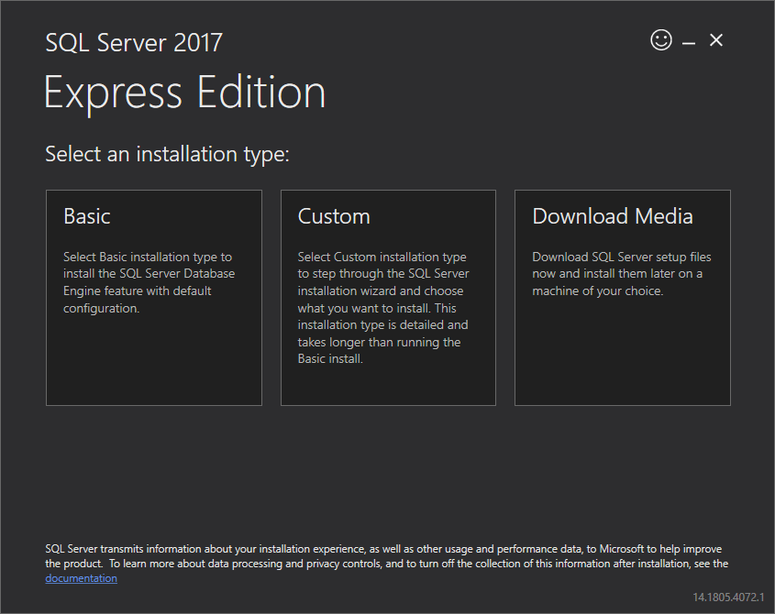
Tools of the Trade
Installing and Downloading
SQL Server Express
https://tinyurl.com/y6y8csu3
Editions
Express
Web
Standard
Enterprise
Developer
https://tinyurl.com/yzbvuyeb

Slide 5



Tools of the Trade
What is an IDE
In layman's terms, this is a environment where you can write your code and/or perform your analysis.

Slide 6
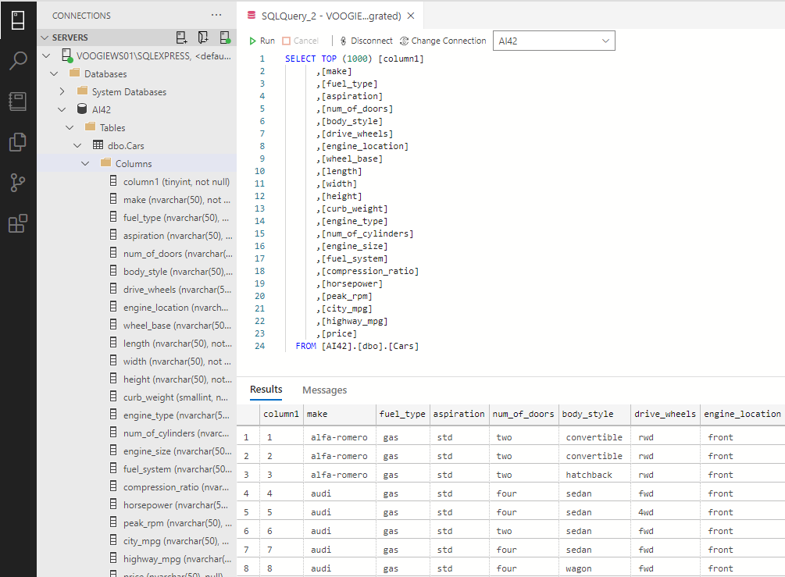
Tools of the Trade
Let’s start to write some code
We will be using Azure Data Studio to start out T-SQL journey.

Slide 7
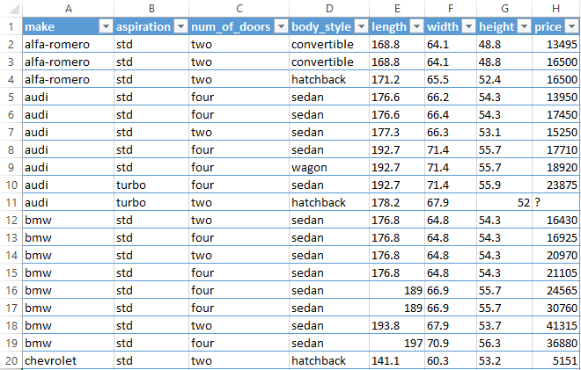
Introduction to T-SQL
Database Objects
Table: A set of related data stored in our database. Excel Reference: a Sheet in Excel
*sample data :https://tinyurl.com/yk5r627h

Slide 8
Introduction to T-SQL
Database Objects
Columns: A set of data of a particular type, generally have a value for each row in our table.
Excel Reference: As show in diagram.
*sample data :https://tinyurl.com/yk5r627h

Slide 9
Introduction to T-SQL
Database Objects
Row: A collection of fields that make up a record. Excel Reference: As show in diagram.
*sample data :https://tinyurl.com/yk5r627h

Slide 10
Introduction to T-SQL
Database Objects
Field: The smallest source of data in a database. Excel Reference: As show in diagram.
*sample data :https://tinyurl.com/yk5r627h

Slide 11
Introduction to T-SQL
Logical Processing Order
FROM
ON
JOIN
WHERE
GROUP BY
WITH CUBE or WITH ROLLUP
HAVING
SELECT
DISTINCT
ORDER BY
TOP
https://tinyurl.com/yzmzktw9

Slide 12
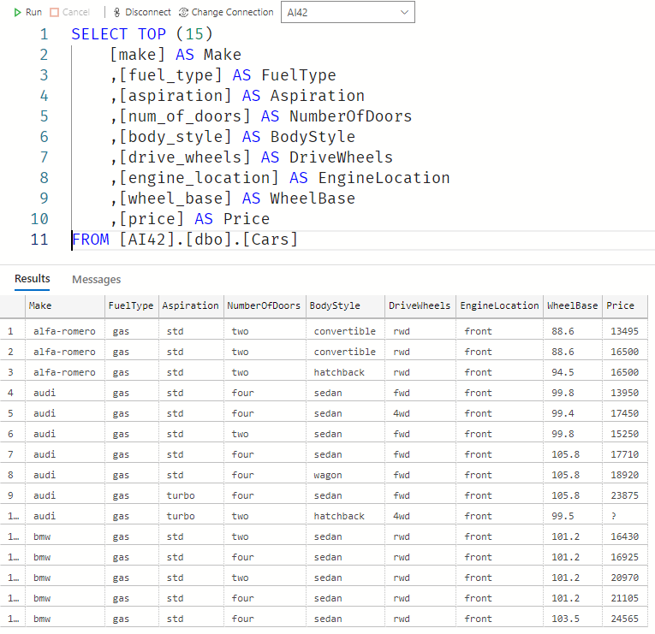
Introduction to T-SQL
Selecting Data
This is the process of retrieving one or many rows or columns from one or many tables in a database. What are we doing? Returning 15 records with our 9 selected columns from the Cars Table
https://tinyurl.com/yzmzktw9

Slide 13
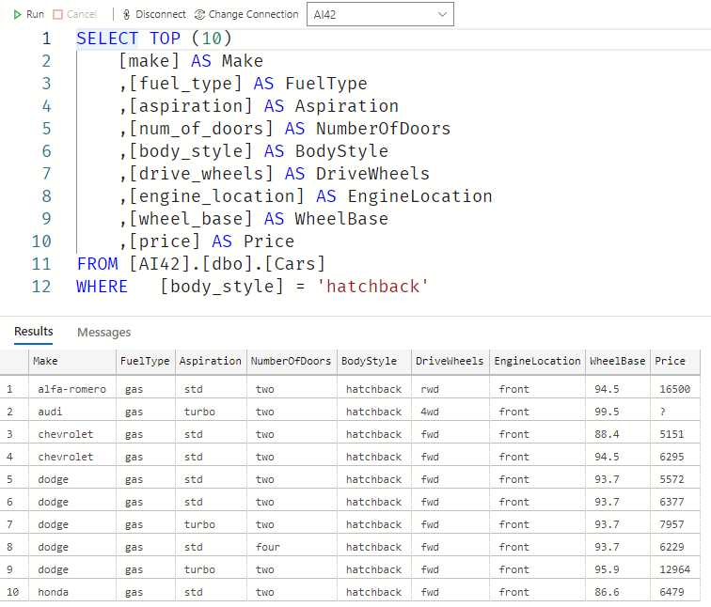
Introduction to T-SQL
Filtering Data
This is the process of excluding data based on predefined rules.
What are we doing? Returning 10 records with our 9 selected columns from the Cars Table where the cars have a body style of type “hatchback”
https://tinyurl.com/yzptzahv

Slide 14
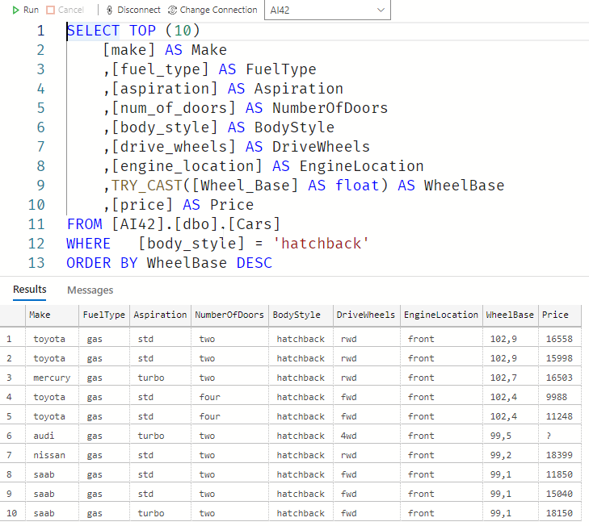
Introduction to T-SQL
Ordering Data
This is the process of sorting a dataset based on a specified sort order.
What are we doing? Returning 10 records with our 9 selected columns from the Cars Table where the cars have a body style of type “hatchback” and ordering them from the widest based on the Wheelbase
https://tinyurl.com/yzjknesq

Slide 15
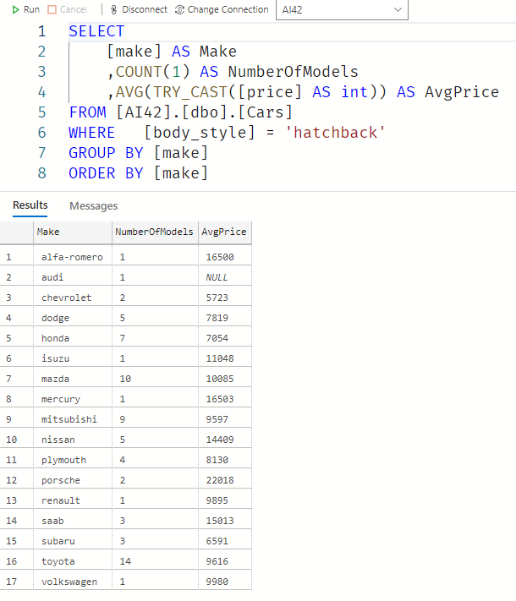
Introduction to T-SQL
Grouping Data
Grouping data within a dataset typically over 1 or more columns.
What are we doing? Returning All the records from the Cars dataset, grouping the data over the Make to see how many Models each Make has that is of Body_Style Hatchback and what is the Average Price for each Model.
https://tinyurl.com/yz2om6ln

Slide 16
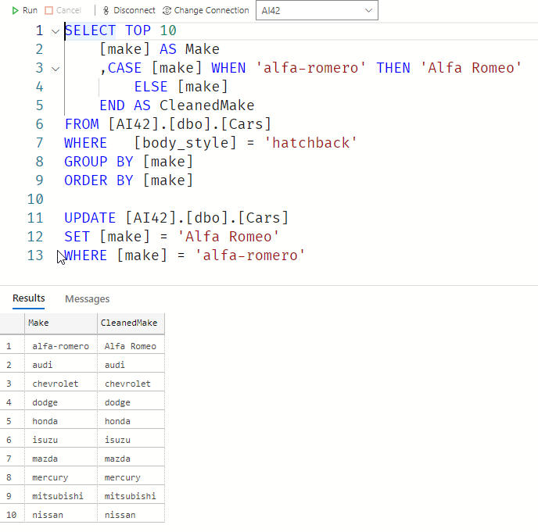
Introduction to T-SQL
Modifying Data
Permanent vs Temporary data modifications. For Permanent we use the UPDATE statement, for temporary we can use what best suite our needs.
What are we doing? We are correcting the spelling error of ‘Alfa Romeo’ in the Make the top statement will only display the corrected data, where the bottom will permanently change the underlying data.
https://tinyurl.com/ygrs2c4r

Slide 17
Multiple datasets
Joining Multiple Datasets
Joining 2 or more datasets together on a common “join” key
C: Inner Join AC: Left Join CB: Right Join
ACB: Full Outer Join
A
B
C
https://tinyurl.com/ye6oj47a

Slide 18
Multiple datasets
Joining Multiple Datasets
Combining 2 datasets that has the same columns, using set theory
C: INTERSECT A: EXCEPT
ACB: UNION, UNION ALL
A
B
C
https://tinyurl.com/ykx6wbjs

Slide 19
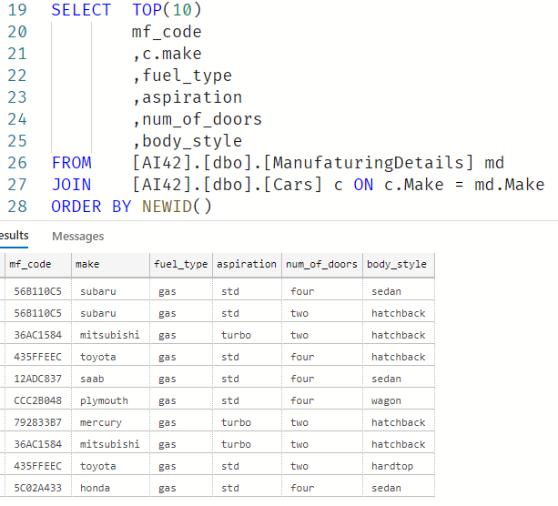
Multiple datasets
Joining Multiple Datasets
https://tinyurl.com/ykx6wbjs

Slide 20
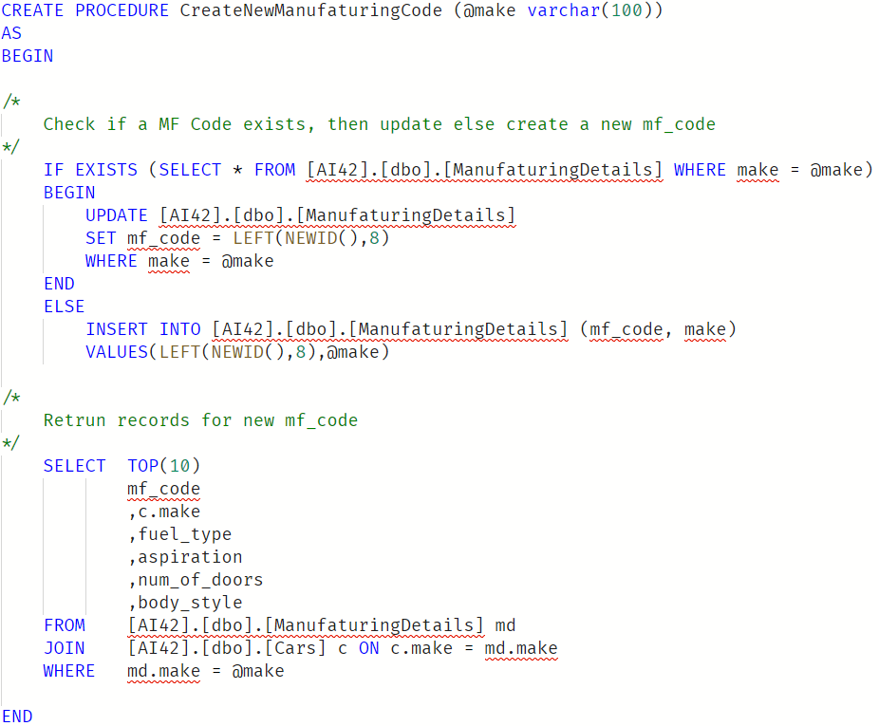
Deep dive
Stored Procedures
An encapsulated set of T-SQL commands that can be ran repeatedly.
https://tinyurl.com/yj3xyvo6

Slide 21
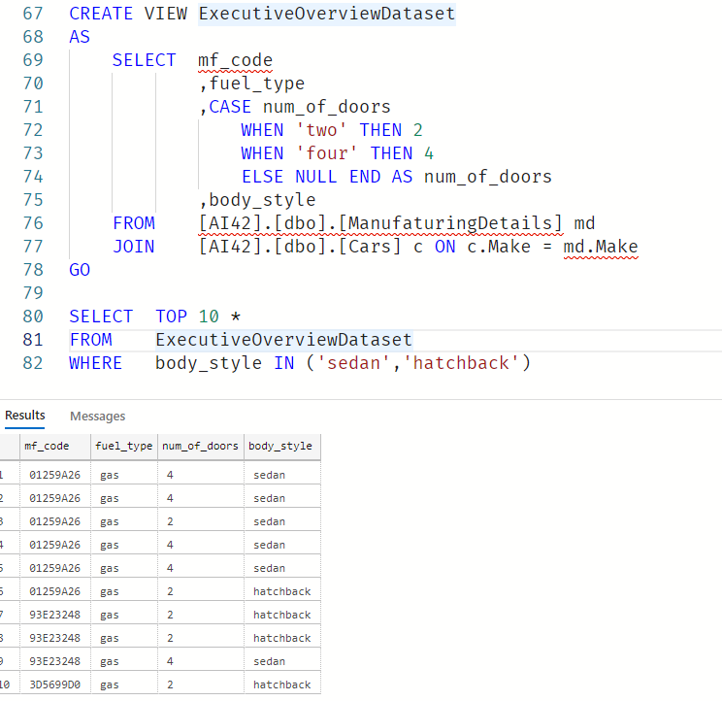
Deep dive
Views
Creates a virtual table with predefined logic, this is useful for repetitive data alterations.
https://tinyurl.com/yh8yhkd8

Slide 22
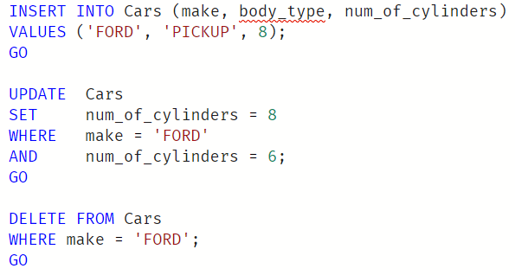
Deep dive
Data Modification CRUD Create - INSERT Read - SELECT Update - UPDATE Delete - DELETE
https://tinyurl.com/yhcjrtvd

Slide 23
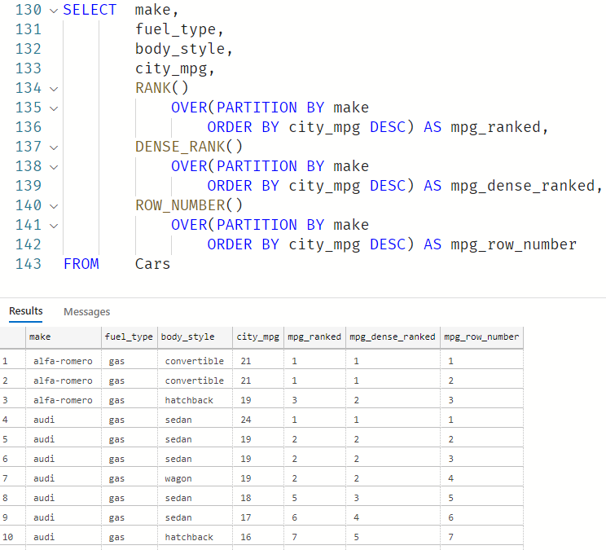
Deep dive
Window Functions
Rank – Returns a rank for each row in our window. 1+ the number in the ranking before it.
https://tinyurl.com/yezmn9s2

Slide 24
Deep dive
Window Functions
Dense Rank -
https://tinyurl.com/yezmn9s2

Slide 25
Deep dive
Window Functions
Row Number -
https://tinyurl.com/yezmn9s2

Slide 26
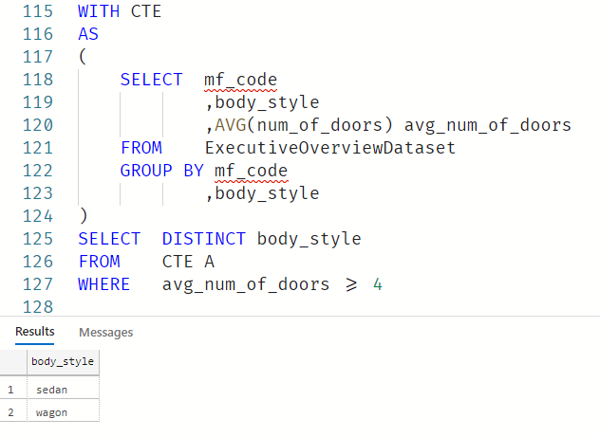
Analytical Functions
Common Table Expressions
https://tinyurl.com/yguqz8ku

Slide 27
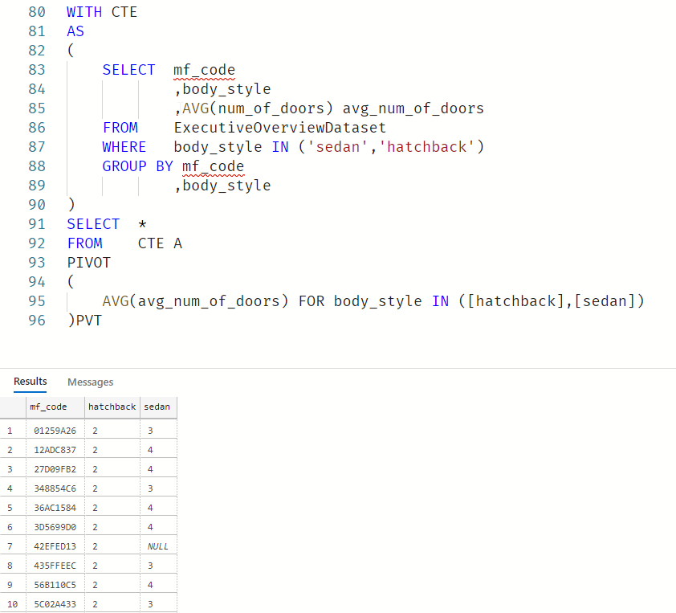
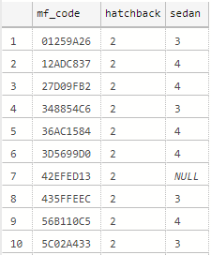
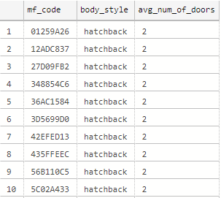
Analytical Functions
Pivot vs Un-pivot
https://tinyurl.com/s5vclxd

Slide 28
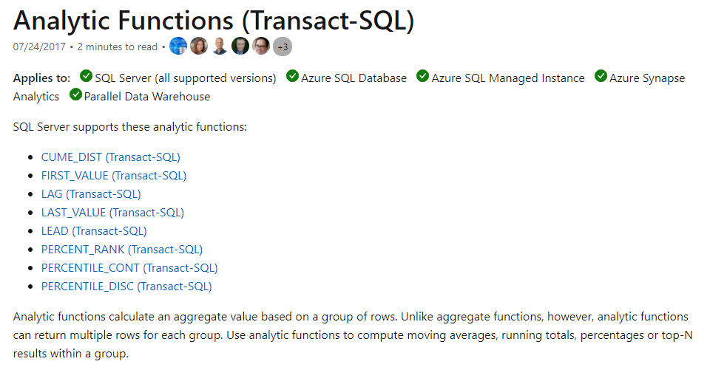
Analytical Functions
Analytical Aggregations
https://tinyurl.com/yjf2h9g6

Slide 29
Additional Resources
Red-gate University - https://github.com/LitKnd/TSQLBeginners
W3schools - https://www.w3schools.com/sql/default.asp
Datacamp - https://www.datacamp.com/courses/introduction-to-sql-server#!
TutorialRepublic - https://www.tutorialrepublic.com/sql-tutorial/
https://tinyurl.com/yjf2h9g6

Slide 30

Questions
https://blog.voogie.online

